Slide 1
SIMULATION AND MEASUREMENT OF RESIDUAL STRESS IN THE WELDMENT OF AN API 5L X60 PIPE
Vitor E. L. Paiva, José L. F. Freire, Leonardo D. Rodrigues, Gilmar W. R. Delgadillo, Ronaldo D. Vieira
Mechanical Engineering Department, PUC-Rio

Slide 2
OBJECTIVES OF THIS WORK
To simulate the process of welding of API pipes using finite element method
To measure the residual stress in the weldment using two different techniques
To analyze the residual stress caused by the welding

Slide 3
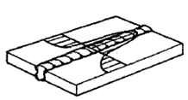
Residual Stress
Stress that exists in components and structures in the absence of forces and temperature gradients
The effects of residual stress in structures can be advantageous or disadvantageous
In fatigue the residual stress is considered part of the mean stress for the life estimation
In welding the residual stress appears in response to the forced heating and cooling of the weldment, which deforms plastic and in a non-uniform way

Slide 4
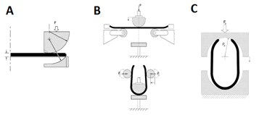
UOE Fabrication Process
The UOE process is divided in 5 steps:
A - The plate edges are first crimped into circular arcs
B – Conformation of the plate in the “U” shape
C – Conformation of the plate in the “O” shape

Slide 5
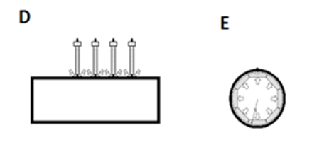
UOE Fabrication Process
D – Initially a small pass of GMAW is done to ensure that the pipe is close, after that a full SAW pass is made to finish closing the pipe
E – Expansion of the pipe is applied in order to improve the circularity

Slide 6
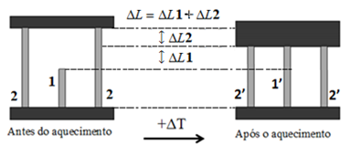
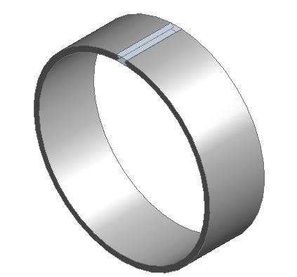
Model for Simulating the Welding
The process of welding can be modeled, for example, as the case were there are three beams with different lengths and the middle beam is heated until it has the same length of the others
The middle beam is individually heated, growing in size until it has the same size of the other two beams
Due to the heating and forced cooling residual stress appears in the system in order to enforce equilibrium and guarantee displacement compatibility

Slide 7
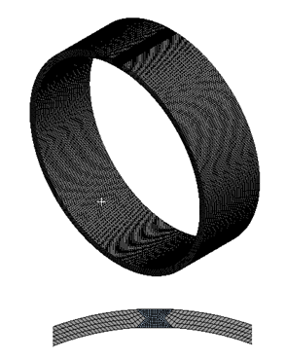
Finite Element Model
The thermal-mechanical behavior of the weld joint was simulated using the finite element method and the hypothetical model of the three beams
The simulation was divided in two parts:
First part: treated the heat transfer between the weld metal and the rest of the pipe
Second part: treated the mechanical behavior of the joint in function of the thermal deformations

Slide 8
Configurations of the Model
It was used the software ANSYS, version 14.5
It were used 54916 nodes and 114600 elements
Types of elements used:
SURF152 – 3D solid element, used for thermal analysis, it has 4 to 10 nodes
TARGE170 – 3D element, used to represent contacts surfaces
CONTA174 – 3D element, used to represent contact surfaces, it has 8 nodes
SOLID186 – 3D solid element with 20 nodes, and 3 degrees of freedom for which node. Used for mechanical analysis

Slide 9
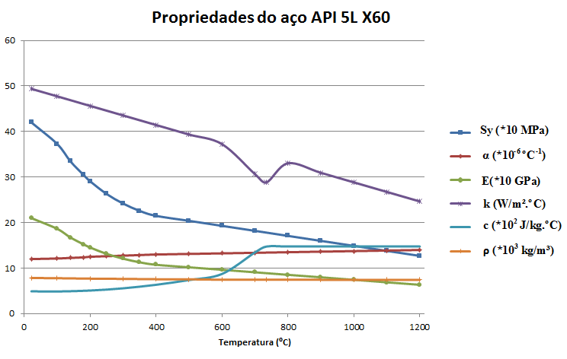
Configurations of the Model
The specimen was made of an API 5L X60 pipe
The diameter was equal to 323.85 mm (12 ¾”), 9.7 mm of thickness and 200 mm of length
Thermal and Mechanical properties changes with the temperature

Slide 10
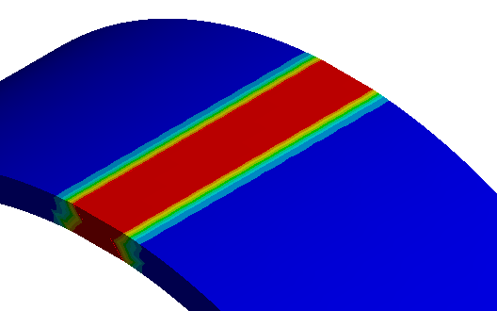
Thermal Part
The temperatures in the weld joint can be predicted over the time by a transient heat transfer analysis
Taking into account the three beams hypothesis, the welding initiates with the weld bead being deposited at the fusion temperature of the steel. After that, boundary conditions are applied considering internal and external convective coefficients respectively equals to 15 and 30 W/m²K until all parts of the pipe return to the environmental temperature of 22⁰C

Slide 11
Thermal Part
Distribution of temperatures in the weld after its deposition from 0s to 100s
1614,2 Max
1424,6
1235,1
1045,6
856,08
666,56
477,04
287,51
22,0 Min

Slide 12
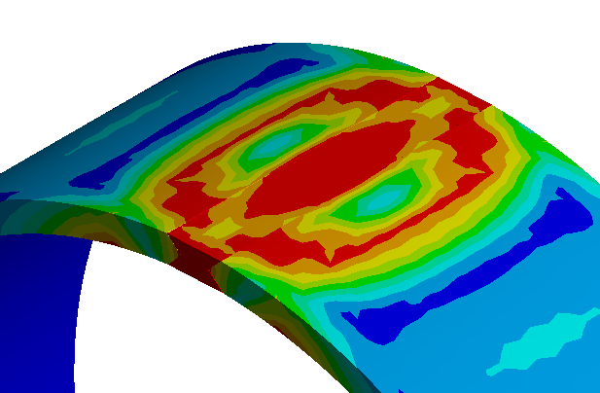
Mechanical Part
The history of temperatures previously obtained was transformed in a thermal load to be imposed into the mechanical model
Stresses and deformations caused by the thermal process were determined by a numerical calculus witch takes into account the elastic-plastic behavior of the material, with the properties changing during the analysis

Slide 13
Mechanical Part
Distribution of Von Mises (Equivalent) Stress in the weldment from 0s to 5000s (thermal equilibrium)

Slide 14
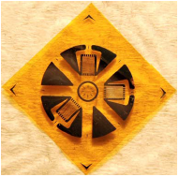
Experimental Procedure
To measure the residual stress generated in the welding process two techniques were applied
Hole-Drilling technique
Elliptical Hole technique
Were used 15 unidirectional strain gage type EA-06-I25AC-350
Were used 57 tri-directional strain gage rosettes PA-06-062RE-120

Slide 15
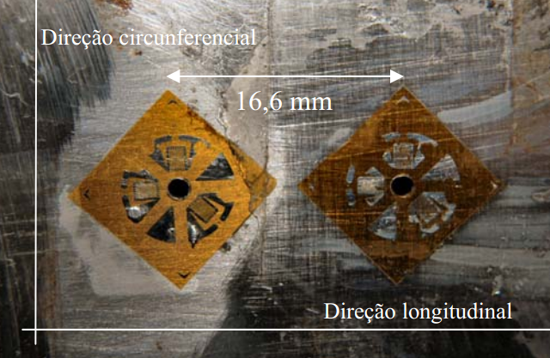
Experimental Procedure
The hole-drilling technique consists of machining a small hole in the component, then measuring the deformation caused by the introduction of the hole

Slide 16
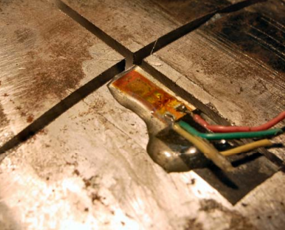
Experimental Procedure
The elliptical-hole technique consists of machining long cuts in the surface of the component, then measuring the deformation caused by the introduction of the cuts

Slide 17
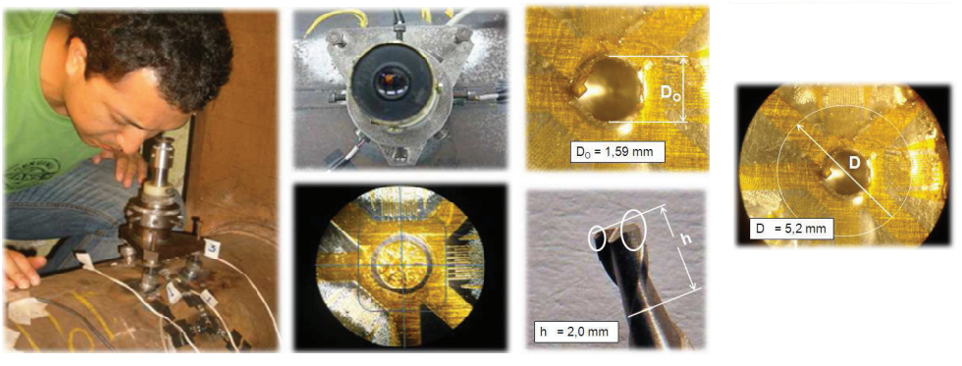
Experimental Procedure

Slide 18
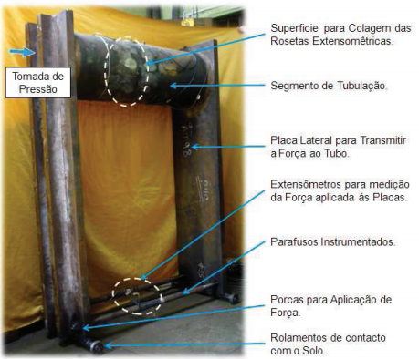
Experimental Procedure
Surface for placing the strain gages
Pipe specimen
Lateral plate used to transmit force to the pipe
Strain gages used to measure the applied force
Instrumented bolts
Nuts for force application
Bearings in contact to the floor
Test bench

Slide 19
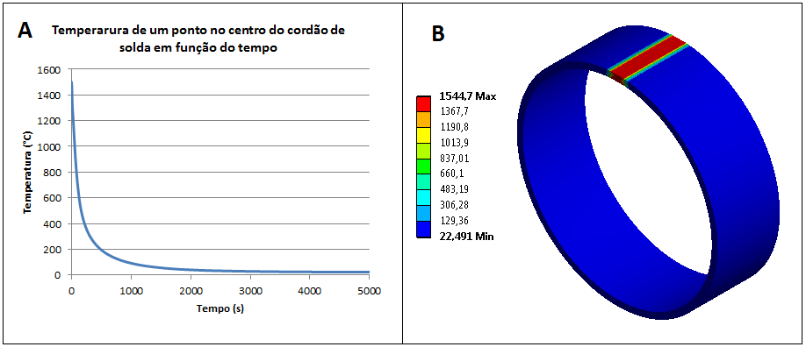
Results
The figure shows the evolution of the temperature in the weldment along the time, after the weld bead has being deposited and cooled using two convection conditions
Temperature of a point in the weld bead over time
Temperature
time

Slide 20
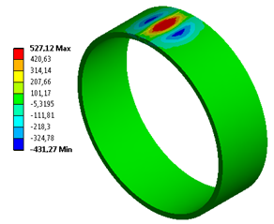
Results
Initially the weld bead is totally expanded and at fusion temperature
In the proportion that the weld bead is cooled it is forced to return to it’s initial size, being in traction; the rest of the joint being in compression, to equilibrate the sum of the forces in the pipe

Slide 21
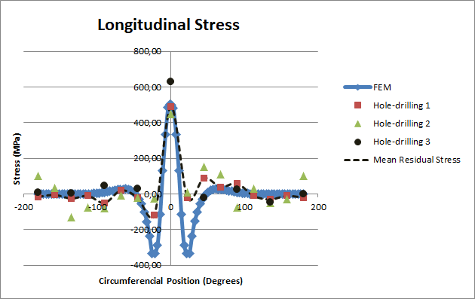
Results

Slide 22
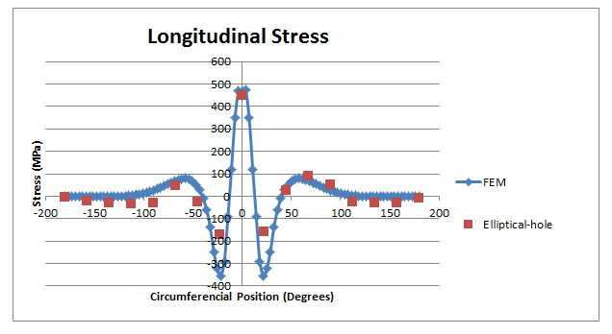
Results

Slide 23
Conclusions
The FEM can be used as an accurate method to predict the behavior of the residual stresses
It was possible to predict the values of the longitudinal residual stress in the pipe caused by the welding
High values of residual stress were founded in the weldment, some of than were at the same level of the material’s yield strength

Slide 24
Thank You

Slide 25
Next Steps

Slide 26
Next Steps

Slide 27
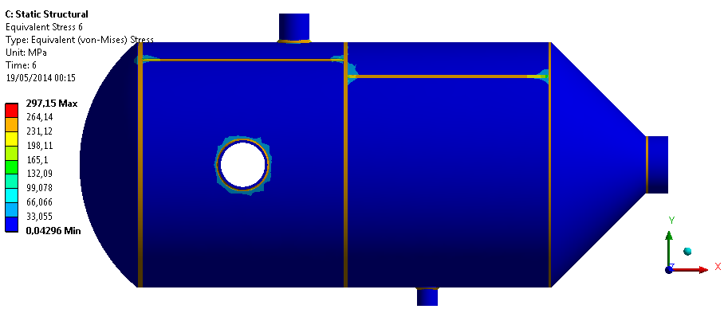
Next Steps

